Slide 1
ELUCIDATING DRUG-DRUG INTERACTIONS UNDERLYING DRUG POLYPHARMACY PROFILES
UNIVERSITY OF COPENHAGEN
FACULTY OF HEALTH AND MEDICAL SCIENCES

Slide 2
Summary
Part I Building a compendia of DDIs information from public databases
Part II Comparison between the different data sources: scattered DDI knowledge
Part III Evaluation of the frequency of DDI in clinical practice using Electronic Health Records

Slide 3
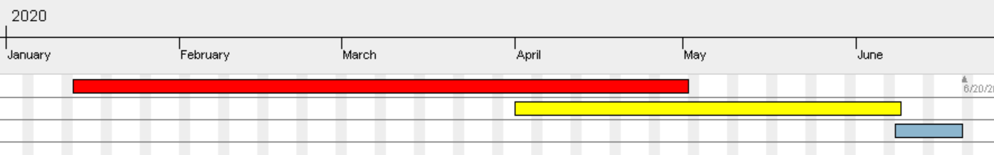
TIMELINE
Reading papers
Extracting and tidying data.
Part II
Part III
Phase 1; DDI Compendia
Phase 2; Computational analysis
Phase 3; TFG

Slide 4
Index
Plan for network analysis and enrichment analysis.
Suggestions for the above topic.
Plan for the following weeks.

Slide 5
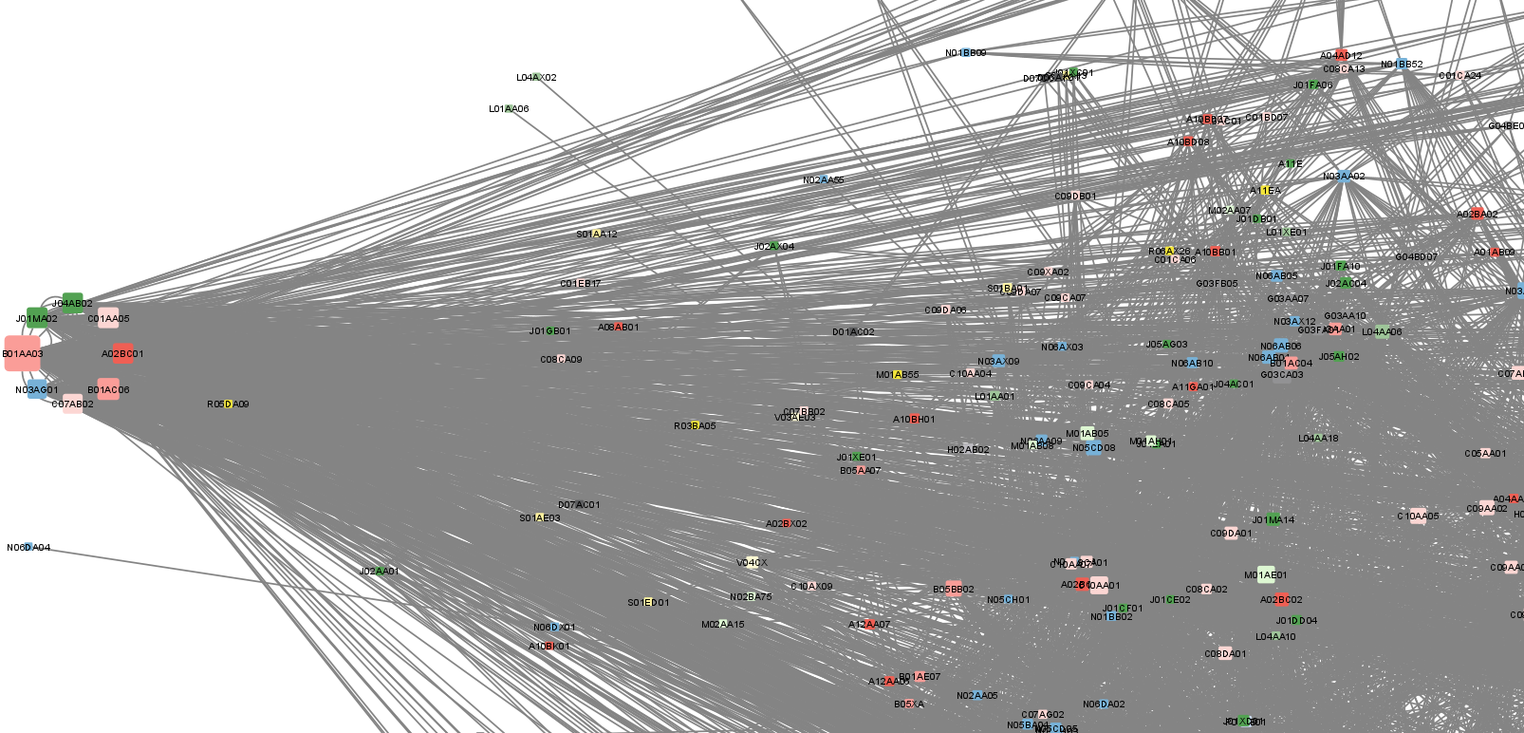
NETWORK ANALYSIS
Check DDIs that are do interact more.
Still workin with apps like CLUSTERONE to make small clusters grouped by the different ATC code

Slide 7
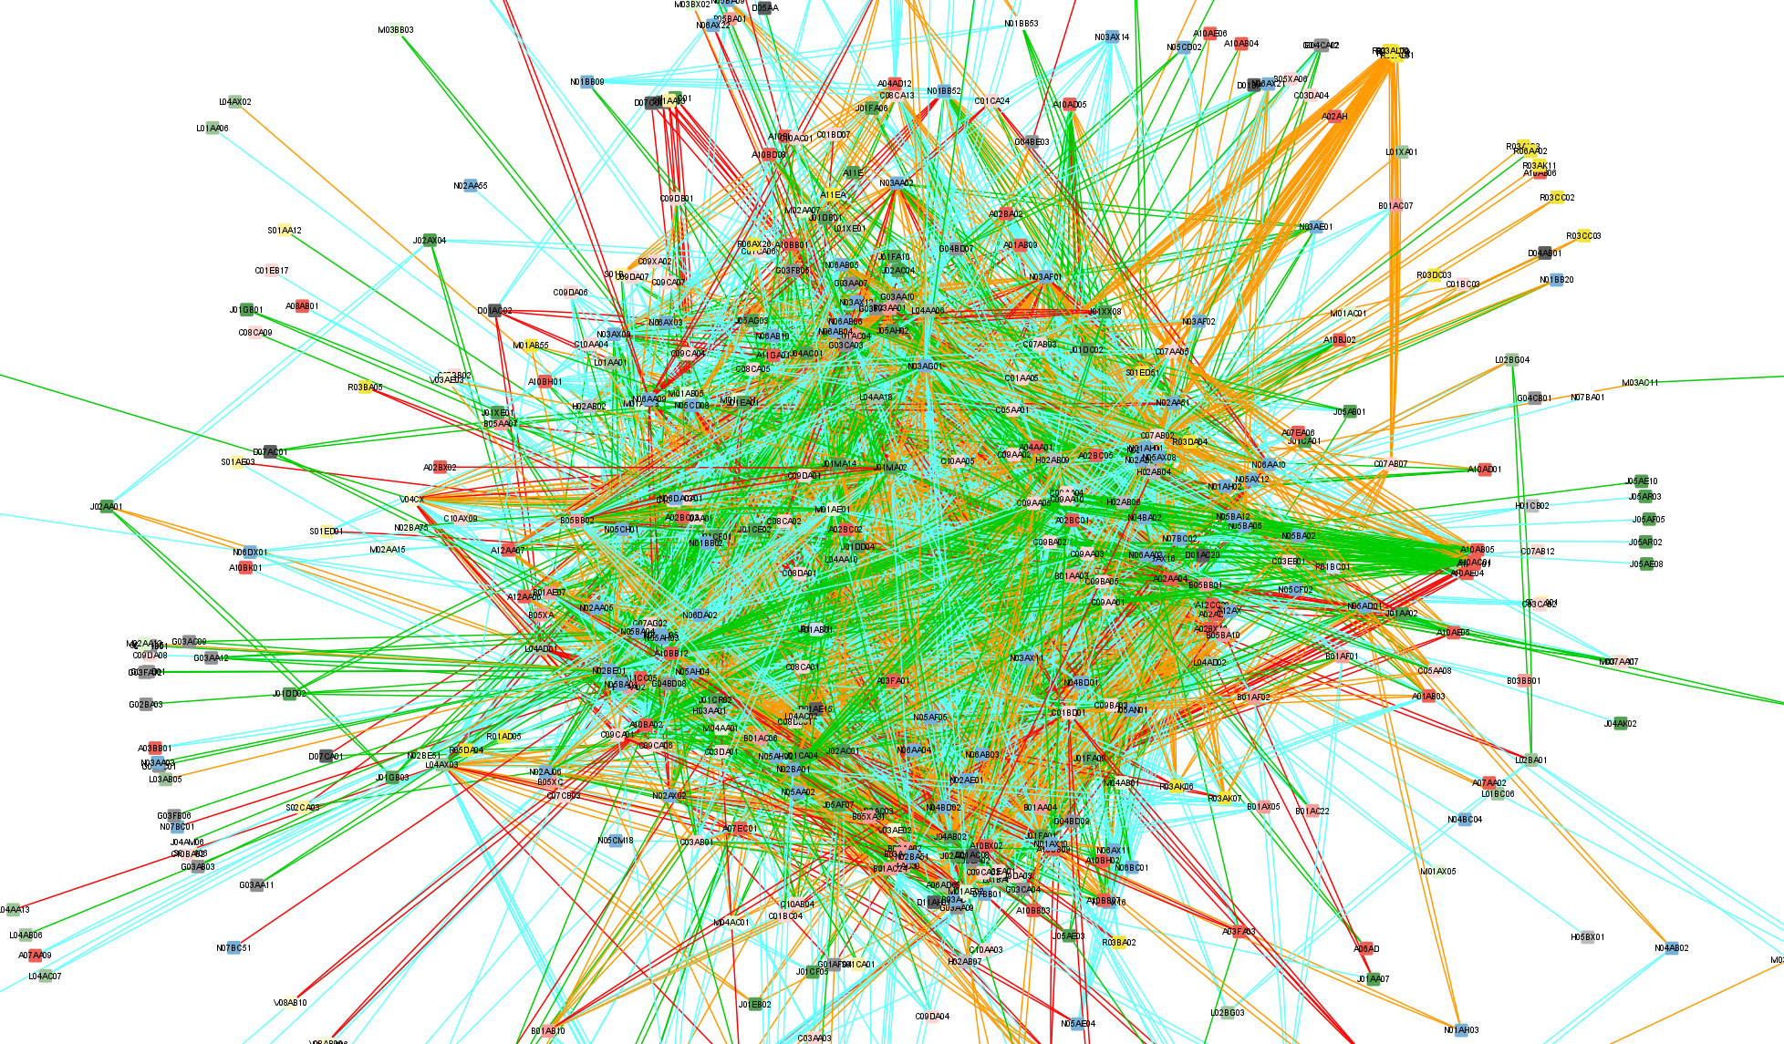
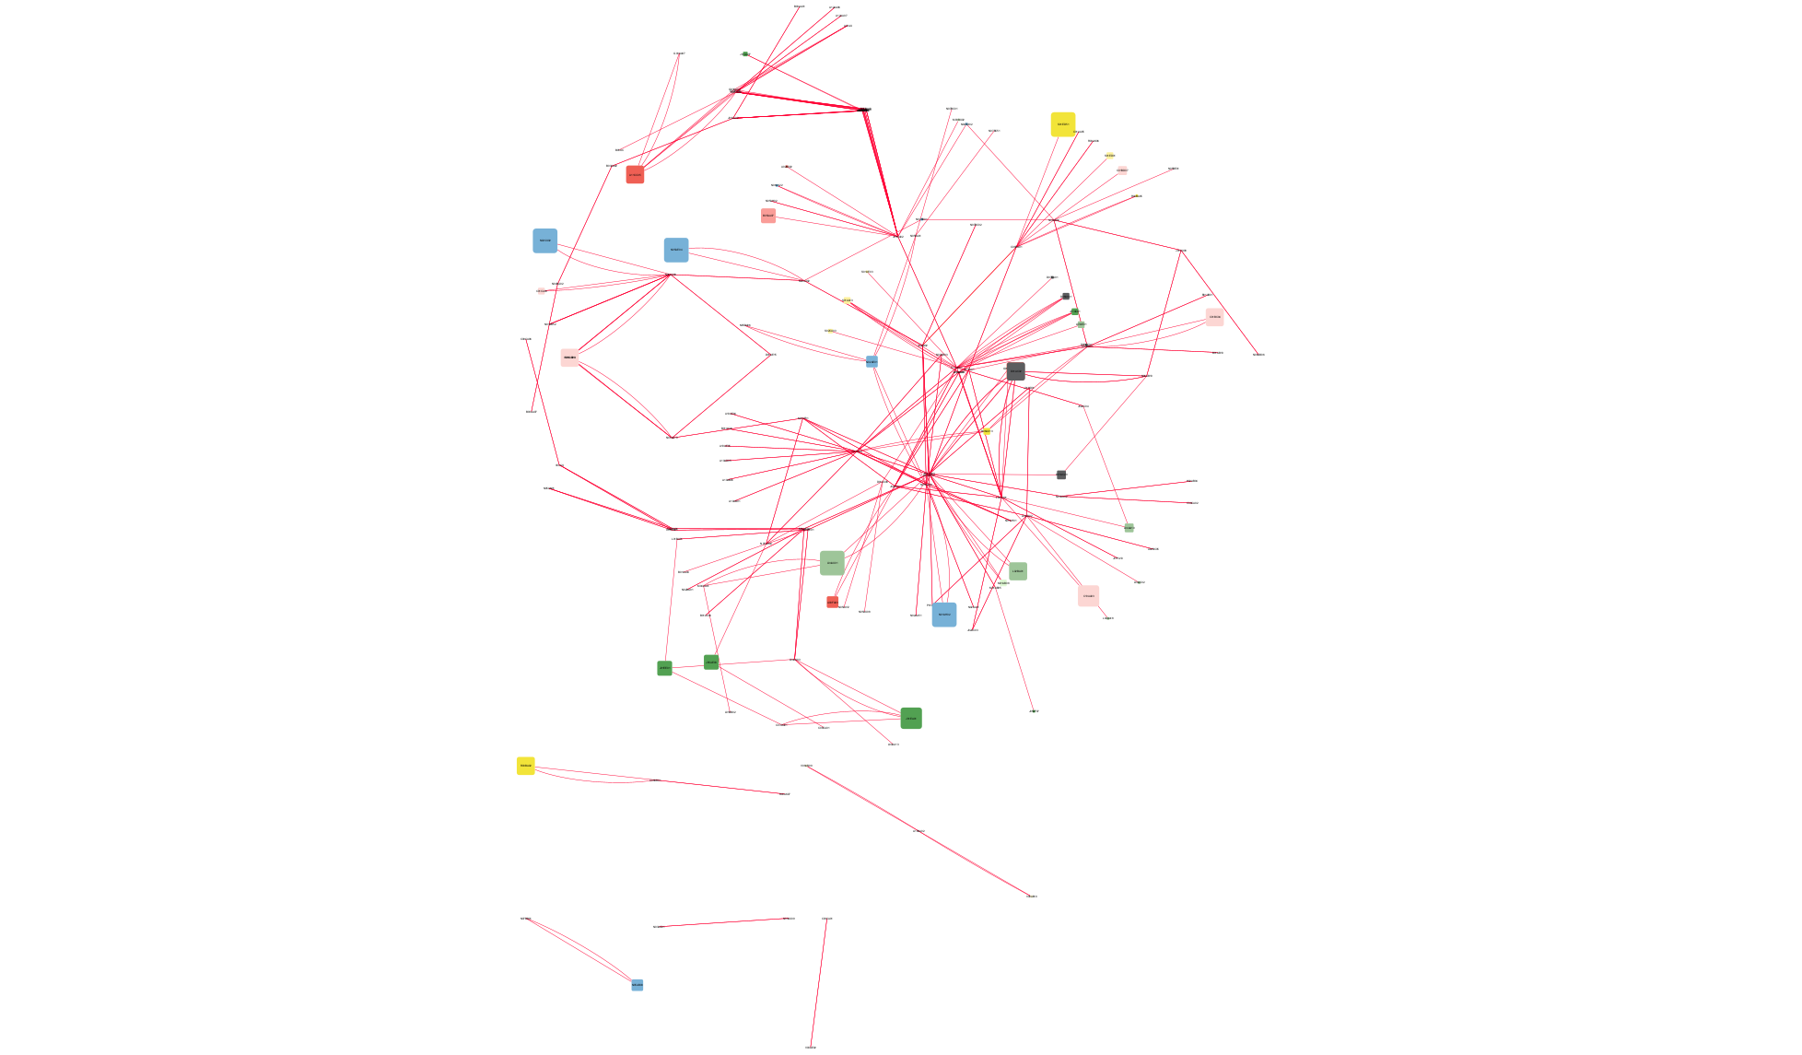
Look at specific features; Clinical significance and management of DDI.
Specifically the most significant cases; can be easier to extract more precise conclusions.

Slide 8
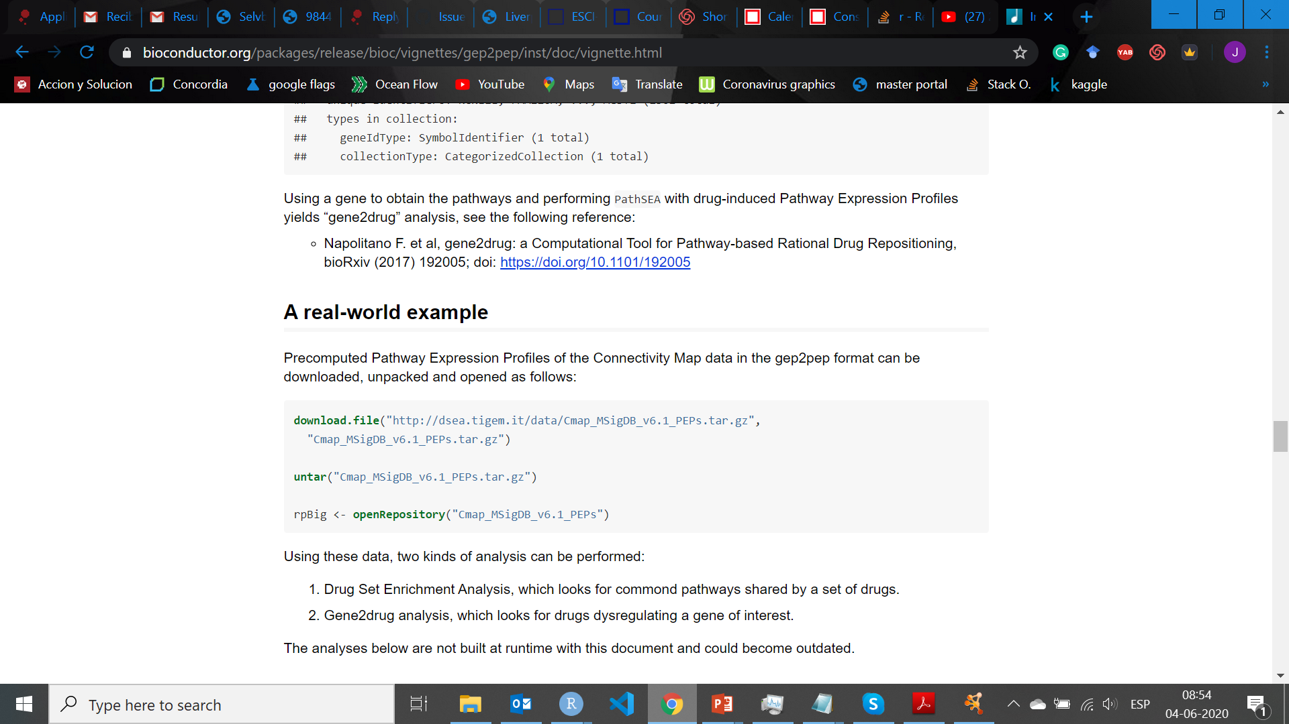
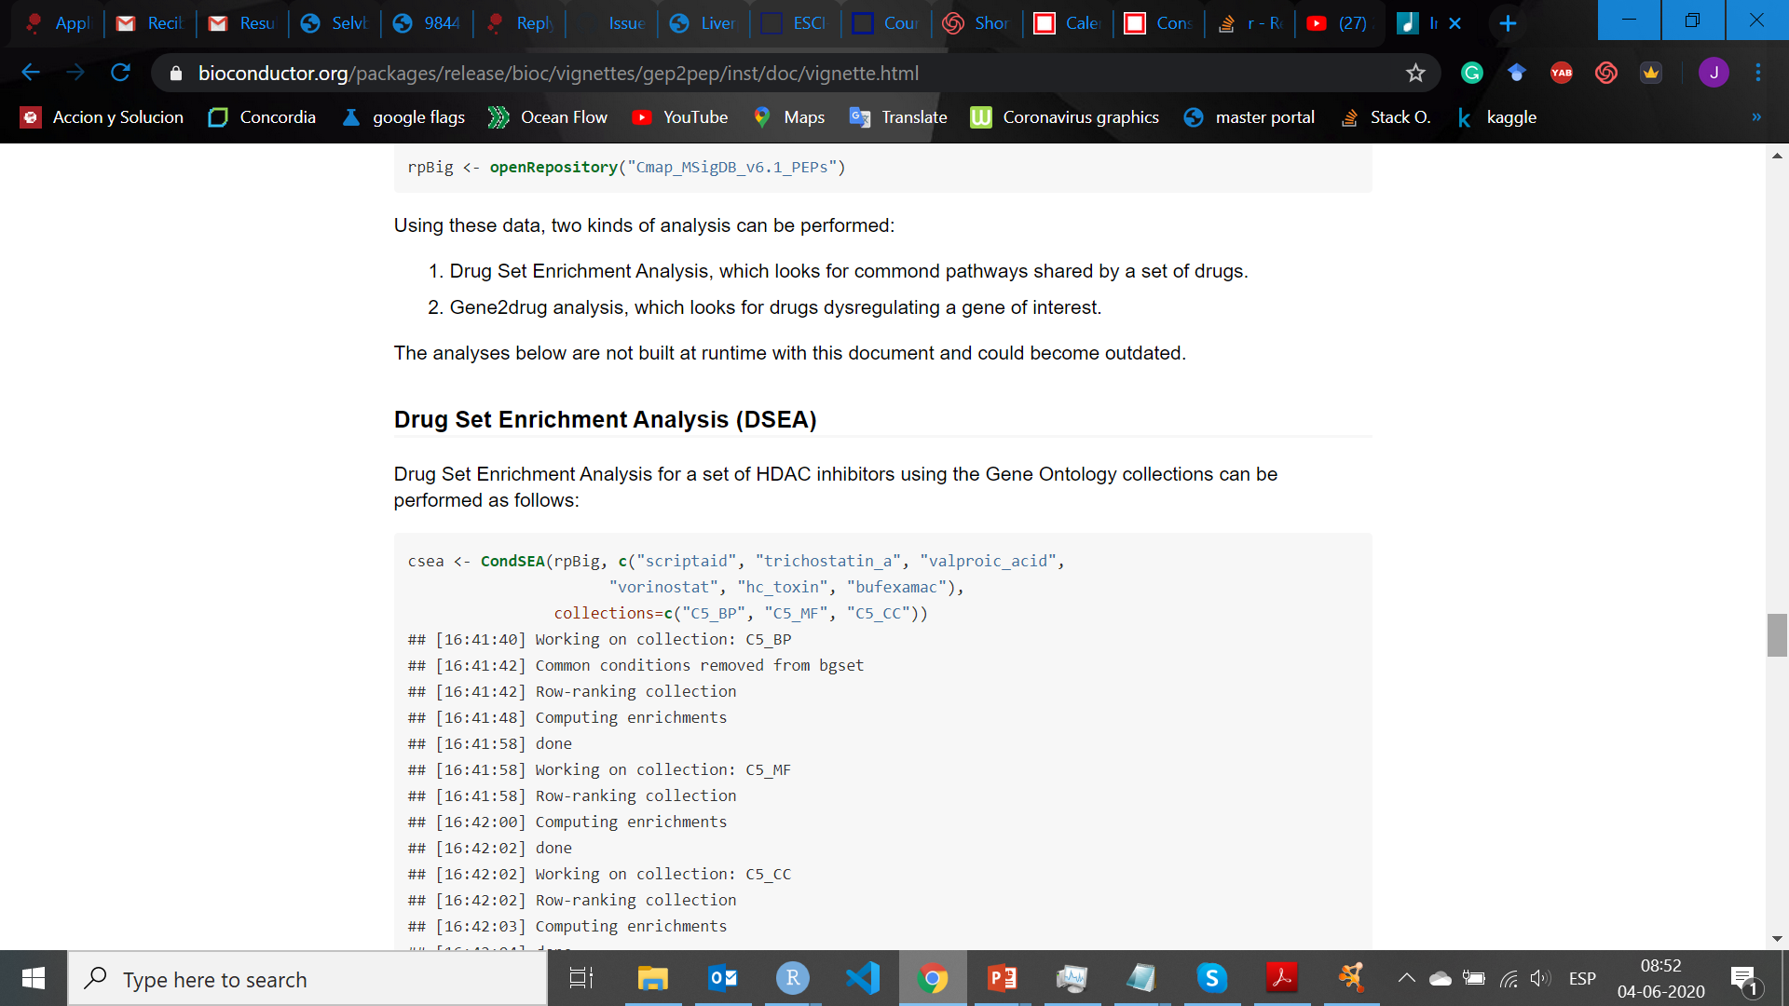
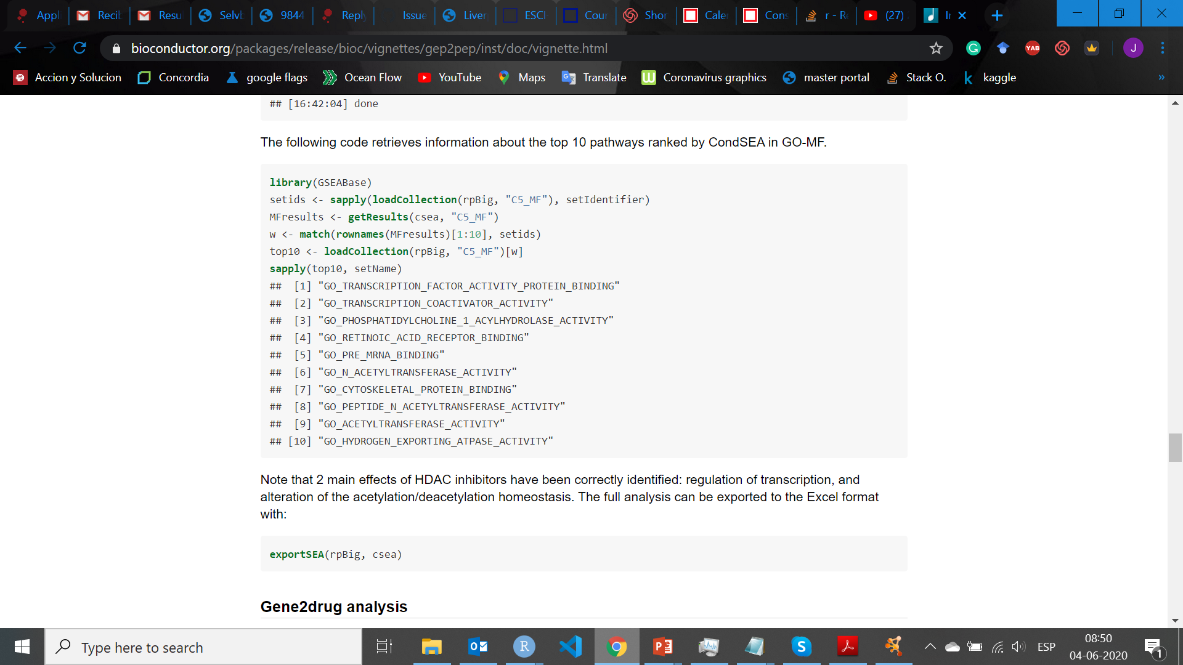
ENRICHMENT ANALYSIS
Enrichment analysis (DSEA)

Slide 9
Any other kind of enrichment analysis that could go through the clinical data?
- Integrating features to clinical data?
- Giving highlights of how my data can detect severe Drug-drug interactions from drug combinations?

Slide 10
THE LAST WEEKS
Finishing analyses for next week.
For next week I will have a complete draft of the FGP.
Last week will be used to finalize any hurries (if any) and give the last touch to the thesis.

